Slide 1
Python for Machine Learning (ML)
Nadia Udler
Lecture 4
Spring 2023

Slide 2
In this lecture
Recommended material
Logistic regression
Neural Networks (ANN, CNN, RNN)
Regularized regression
Kernel Methods

Slide 3
Recommended material
OpenML datasets
https://www.openml.org/search?type=data&from=100
Stanford University – Lecture on Logistic regression
https://www.youtube.com/watch?v=het9HFqo1TQ
Stanford University – Lecture on Neural Networks
https://www.youtube.com/watch?v=MfIjxPh6Pys
Stanford University – Introduction to Convolutional Neural Networks
https://www.youtube.com/watch?v=vT1JzLTH4G4&list=PL3FW7Lu3i5JvHM8ljYj-zLfQRF3EO8sYv
Tensorflow RNN example
https://www.tensorflow.org/guide/keras/rnn#rnn_state_reuse
Tensorflow tutorial – sentiment analysis of movie reviews
https://www.tensorflow.org/tutorials/text/text_classification_rnn
Lasso Regression
sklearn.linear_model.Lasso — scikit-learn 0.24.2 documentation
https://www.tutorialspoint.com/scikit_learn/scikit_learn_lasso.htm
Ridge Regression
https://scikit-learn.org/stable/modules/generated/sklearn.linear_model.Ridge.html
https://www.tutorialspoint.com/scikit_learn/scikit_learn_ridge_regression.htm

Slide 4
Logistic Regression
Automatic airplanes classification
Can we use linear regression to fit this data? If not why not?

Slide 5
Logistic Regression
Automatic airplanes classification
Linear regression model required real valued response variable
Binary or categorical response– cannot use linear regression
Logistic regression - type of classification method

Slide 6
Logistic Regression
Real life example: predicting firm defaults
Firm default is an example of a qualitative response—at least if we do not look at the severity of default in terms of recoveries. We simply observe a firm’s characteristics and whether it defaults or not.
Suppose that a firm may be in one of two states: in default or not in default.
Firm characteristics:
WC_TA – working capital/total assets
RE_TA - retained earnings/total assets
EBIT_TA - earnings before interests and taxes/total assets
WC_TA | RE_TA | EBIT_TA | Industry | Rating | No Default
0.013 | 0.104 | 0.036 | 3 | BB | 1
0.232 | 0.335 | 0.062 | 8 | A | 1
0.311 | 0.367 | 0.074 | 1 | A | 1
0.194 | 0.263 | 0.062 | 4 | BBB | 1
0.121 | 0.413 | 0.057 | 12 | AAA | 1
-0.117 | -0.799 | 0.01 | 4 | CCC | 0
0.087 | 0.158 | 0.049 | 2 | BBB | 1
0.005 | 0.181 | 0.034 | 7 | AA | 1
0.47 | 0.752 | 0.07 | 8 | AAA | 1
0.11 | 0.337 | 0.045 | 4 | AAA | 1
-0.108 | -0.615 | 0.017 | 11 | CCC | 0

Slide 7
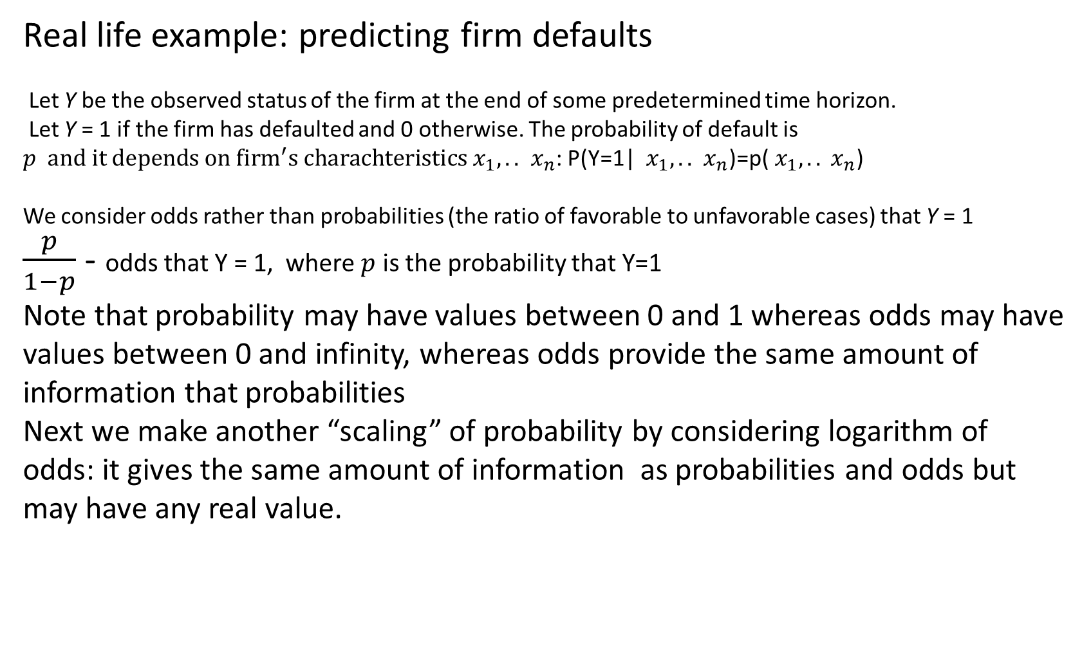
Logistic Regression
Real life example: predicting firm defaults
Let Y be the observed status of the firm at the end of some predetermined time horizon.
Let Y = 1 if the firm has defaulted and 0 otherwise. The probability of default is $p and it depends on {firm}^{′}s charachteristics{ x}_{1},..$ ${ x}_{n}$: P(Y=1| ${ x}_{1},..$ ${ x}_{n}$)=p(${ x}_{1},..$ ${ x}_{n}$)
We consider odds rather than probabilities (the ratio of favorable to unfavorable cases) that Y = 1
$\frac{p}{1−p}$ - odds that Y = 1, where $p$ is the probability that Y=1
Note that probability may have values between 0 and 1 whereas odds may have values between 0 and infinity, whereas odds provide the same amount of information that probabilities
Next we make another “scaling” of probability by considering logarithm of odds: it gives the same amount of information as probabilities and odds but may have any real value.

Slide 8
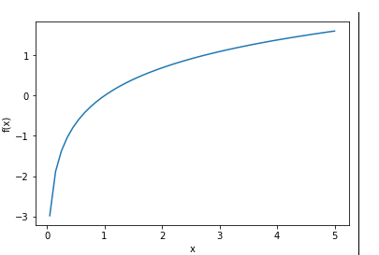
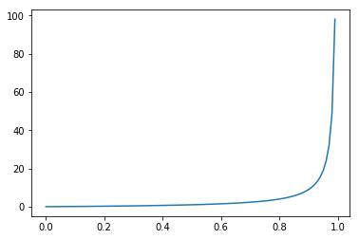
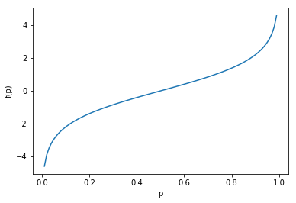
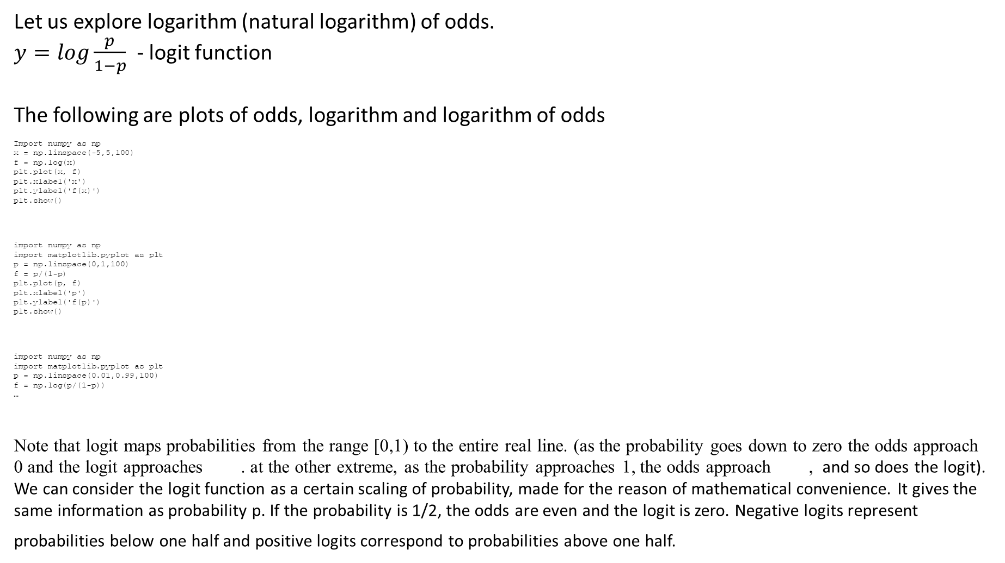
Logistic Regression
Let us explore logarithm (natural logarithm) of odds.
$y=log\frac{p}{1−p}$ - logit function
The following are plots of odds, logarithm and logarithm of odds
Import numpy as np
x = np.linspace(-5,5,100)
f = np.log(x)
plt.plot(x, f)
plt.xlabel('x')
plt.ylabel('f(x)')
plt.show()
import numpy as np
import matplotlib.pyplot as plt
p = np.linspace(0,1,100)
f = p/(1-p)
plt.plot(p, f)
plt.xlabel('p')
plt.ylabel('f(p)')
plt.show()
import numpy as np
import matplotlib.pyplot as plt
p = np.linspace(0.01,0.99,100)
f = np.log(p/(1-p))
…
Note that logit maps probabilities from the range [0,1) to the entire real line. (as the probability goes down to zero the odds approach 0 and the logit approaches . at the other extreme, as the probability approaches 1, the odds approach , and so does the logit). We can consider the logit function as a certain scaling of probability, made for the reason of mathematical convenience. It gives the same information as probability p. If the probability is 1/2, the odds are even and the logit is zero. Negative logits represent probabilities below one half and positive logits correspond to probabilities above one half.

Slide 9
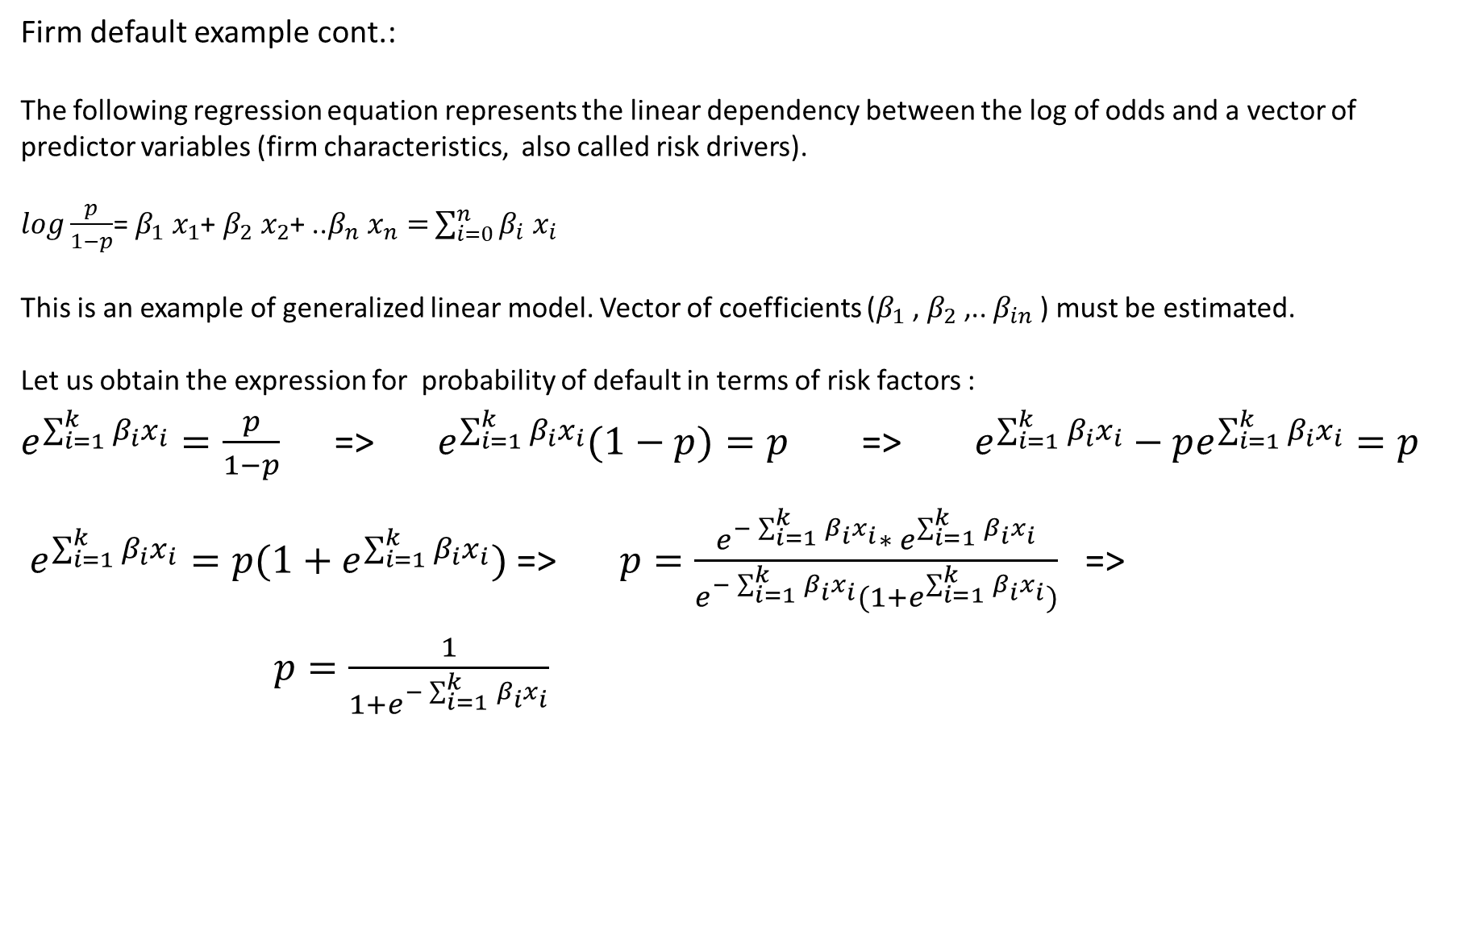
Logistic Regression
Firm default example cont.:
The following regression equation represents the linear dependency between the log of odds and a vector of predictor variables (firm characteristics, also called risk drivers).
$log\frac{p}{1−p}$= $β_{1} x_{1}$+ $β_{2} x_{2}$+ ..$β_{n} x_{n}=$ $\sum_{i=0}^{n}{β_{i} x_{i}}$
This is an example of generalized linear model. Vector of coefficients ($β_{1}$, $β_{2}$,.. $β_{in}$) must be estimated.
Let us obtain the expression for probability of default in terms of risk factors :
$e^{\sum_{i=1}^{k}{β_{i}x_{i}}}=\frac{p}{1−p}$ => $e^{\sum_{i=1}^{k}{β_{i}x_{i}}}(1−p)=p$ => $e^{\sum_{i=1}^{k}{β_{i}x_{i}}}−pe^{\sum_{i=1}^{k}{β_{i}x_{i}}}=p$
$e^{\sum_{i=1}^{k}{β_{i}x_{i}}}=p(1+e^{\sum_{i=1}^{k}{β_{i}x_{i}}})$ => $p=\frac{{e^{−\sum_{i=1}^{k}{β_{i}x_{i}}}∗ e}^{\sum_{i=1}^{k}{β_{i}x_{i}}}}{e^{−\sum_{i=1}^{k}{β_{i}x_{i}}}(1+e^{\sum_{i=1}^{k}{β_{i}x_{i}}})}$ =>
$p=\frac{1}{1+e^{−\sum_{i=1}^{k}{β_{i}x_{i}}}}$

Slide 10
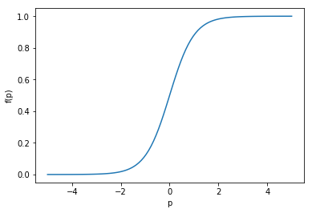
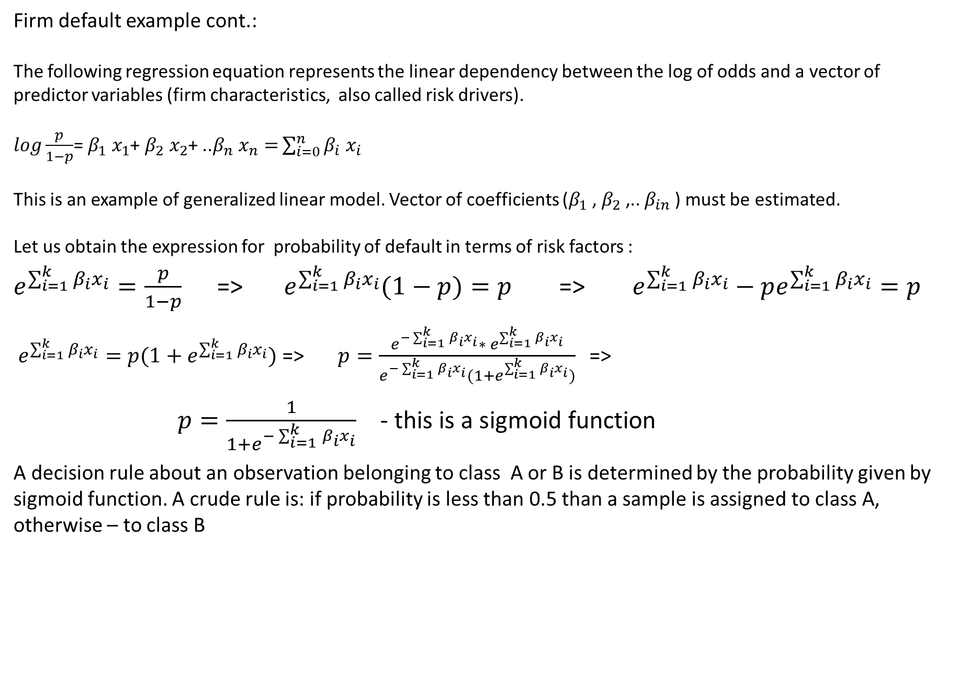
Logistic Regression
Firm default example cont.:
The following regression equation represents the linear dependency between the log of odds and a vector of predictor variables (firm characteristics, also called risk drivers).
$log\frac{p}{1−p}$= $β_{1} x_{1}$+ $β_{2} x_{2}$+ ..$β_{n} x_{n}=$ $\sum_{i=0}^{n}{β_{i} x_{i}}$
This is an example of generalized linear model. Vector of coefficients ($β_{1}$, $β_{2}$,.. $β_{in}$) must be estimated.
Let us obtain the expression for probability of default in terms of risk factors :
$e^{\sum_{i=1}^{k}{β_{i}x_{i}}}=\frac{p}{1−p}$ => $e^{\sum_{i=1}^{k}{β_{i}x_{i}}}(1−p)=p$ => $e^{\sum_{i=1}^{k}{β_{i}x_{i}}}−pe^{\sum_{i=1}^{k}{β_{i}x_{i}}}=p$
$e^{\sum_{i=1}^{k}{β_{i}x_{i}}}=p(1+e^{\sum_{i=1}^{k}{β_{i}x_{i}}})$ => $p=\frac{{e^{−\sum_{i=1}^{k}{β_{i}x_{i}}}∗ e}^{\sum_{i=1}^{k}{β_{i}x_{i}}}}{e^{−\sum_{i=1}^{k}{β_{i}x_{i}}}(1+e^{\sum_{i=1}^{k}{β_{i}x_{i}}})}$ =>
$p=\frac{1}{1+e^{−\sum_{i=1}^{k}{β_{i}x_{i}}}}$ - this is a sigmoid function
A decision rule about an observation belonging to class A or B is determined by the probability given by sigmoid function. A crude rule is: if probability is less than 0.5 than a sample is assigned to class A, otherwise – to class B

Slide 11
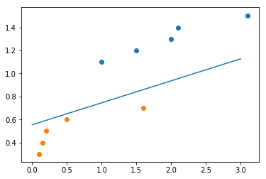
Logistic Regression
Back to automatic airplane classification example:
The below data can be used to train logistic regression to recognize airplanes.
from sklearn.linear_model import LogisticRegression
lr=LogisticRegression()
x=list(zip(X_bomber_mass,X_bomber_speed))
x1=list(zip(X_fighter_mass,X_fighter_speed))
x.extend(x1)
y=[0,0,0,0,0,1,1,1,1,1]
lrfit = lr.fit(x,y)
For better visualization the familiar figure from ‘linear models’
topic is presented: simple linear classification of airplanes
As we already know logistic regression builds continuous model that connects characteristics of airplanes with its class. In other words, when airplane with certain characteristics is given to the model it returns the probability p of being in certain class (or probability (1-p) of not being in this class). Hence the term ‘regression’ for logistic regression is more appropriate than ‘classifier’ because internally the model works as linear regression.
The code trains logistic regression model with given data and then predicts the probability of the given airplane to be in first or second class. The default implementation of scikit-learn logistic regression assigns class A to the observation if the probability of being in class A is greater than 50%.

Slide 12
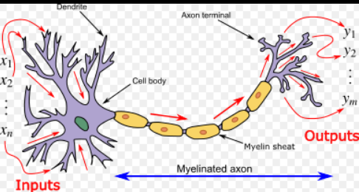
Neural Networks
Biological Neuron: Courtesy of Wikipedia

Slide 13
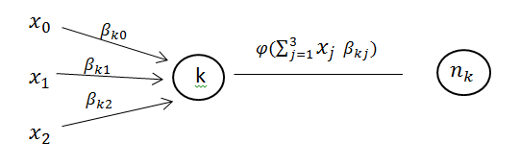
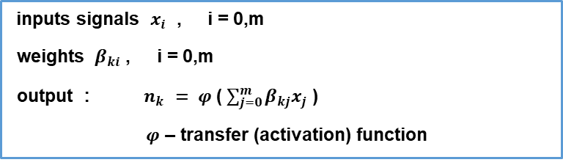
Artificial Neuron that Mimics Biological Neuron
inputs signals $x_{i}$ , i = 0,m
weights $β_{ki}$ , i = 0,m
output : $n_{k }= φ$($\sum_{j=0}^{m}{β_{kj}x_{j}}$)
$φ$ – transfer (activation) function

Slide 14
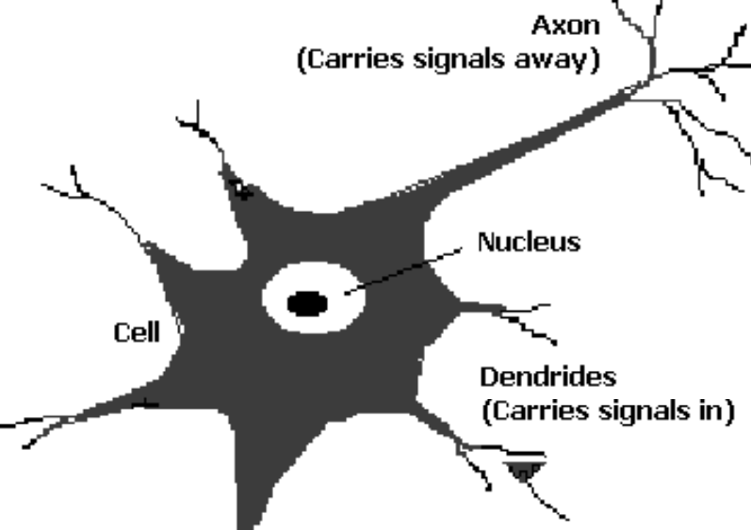
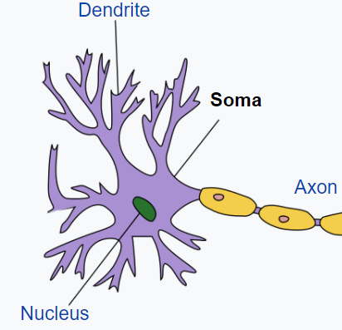
Biological Neuron
Picture:
Neural Nets and Neuro Computers, P.G. Krug, MEI, 2002
Picture:
From Wikipedia
Dendrites – carries signals in
Synapse (neuronal junction) - the site of transmission of electric nerve impulses between two neurons or between a neuron and a gland or muscle cell . Synapse determines strength of the signal through synaptic neurotransmitters – chemicals that are released into synapse , their quantity determines the strength of the signal
Soma – acts as a summation function
Axon –gets its signal from the summation behavior which occurs inside the soma. Once the soma reaches a certain potential (threshold) , the axon will transmit the signal

Slide 15
Biological Neuron
Picture:
Neural Nets and Neuro Computers, P.G. Krug, MEI, 2002
Picture:
From Wikipedia
Activation - Once the soma reaches a certain potential (threshold) , the axon will transmit the signal
Neuron network learns to release the correct quantity of chemical substance in neurotransmitters through repeated scenarios such as in Pavlov’s dog experiment https://en.wikipedia.org/wiki/Classical_conditioning

Slide 16
History of Artificial Neural Networks
Artificial Neuron – Warren McCallouch, Pitt, 1943)
Perceptron – first binary classifier( Frank Rosenblatt, 1957)
(one layer feed forward neural network with identity activation function)
https://en.wikipedia.org/wiki/Perceptron
Kernel Perceptron – first online non-linear classifier (Aizerman, Braverman, Rosonoer,1964)
https://en.wikipedia.org/wiki/Kernel_perceptron
Perceptrons – book ( Marvin Minsky and Seymour Papert, 1969)
Neural Networks Theory – book (Alexander Galushkin, Springer, 2007)

Slide 17
Perceptron: Example 1
Robot helps a professor to grade students on the test
There are two problems on the test.
“Passed’ grade should be given to a student if both problems are solved (correctly).
Possible situations
Problem1 Problem2 Grade
Solved Solved Passed
Solved Not Solved Not Passed
Not Solved Solved Not Passed
Not Solved Not Solved Not Passed

Slide 18
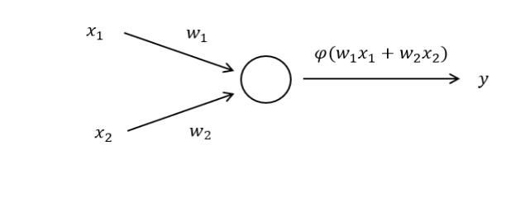
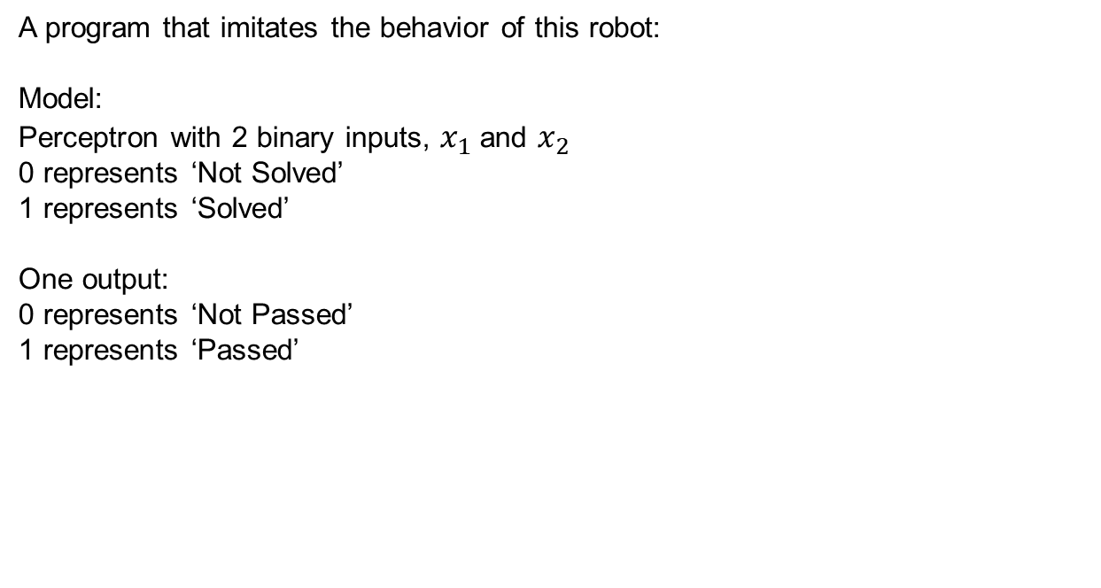
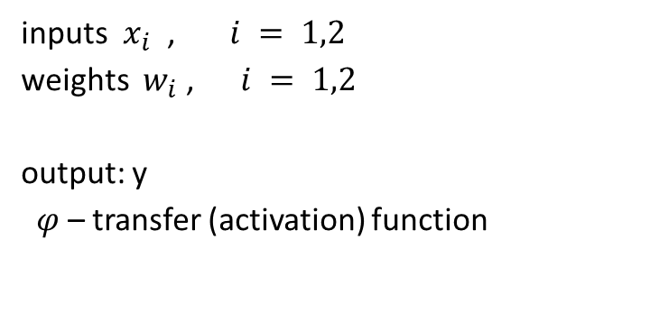
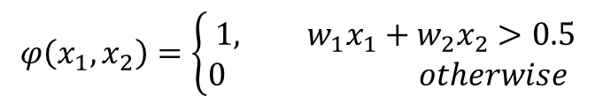
Perceptron: Example 1
A program that imitates the behavior of this robot:
Model:
Perceptron with 2 binary inputs, $x_{1}$and $x_{2}$
0 represents ‘Not Solved’
1 represents ‘Solved’
One output:
0 represents ‘Not Passed’
1 represents ‘Passed’
inputs $x_{i}$ , $i = 1,2$
weights $w_{i}$ , $i = 1,2$
output: y
$φ$ – transfer (activation) function
$$φ\left({x_{1},x}_{2}\right)=\left\{\begin{aligned}& 1, {w_{1}x}_{1}+{w_{2}x}_{2}>0.5 \\ &0 otherwise\end{aligned}\right.$$

Slide 19
Perceptron: Example 1
A program that imitates the behavior of this robot:
in_data
0 0 0
0 1 0
1 0 0
1 1 1
import numpy as np
def Perceptron(n, in_data, weights=None):
if weights is None:
weights = np.ones(n) * 0.5
weighted_input = weights * in_data
weighted_sum = weighted_input.sum()
return unit_step_function(weighted_sum)
def unit_step_function(x):
if x > 0.5:
return 1
return 0
for x in [np.array([0, 0]), np.array([0, 1]), np.array([1, 0]), np.array([1, 1])]:
y = Perceptron(2, np.array(x))
print(x, y)

Slide 20
Perceptron: Example 1
A program that imitates the behavior of this robot: (OOP)
import numpy as np class Perceptron:
def __init__(self, input_length, weights=None):
if weights is None:
self.weights = np.ones(input_length) * 0.5
else:
self.weights = weights
@staticmethod
def unit_step_function(x):
if x > 0.5:
return 1
return 0
def __call__(self, in_data):
weighted_input = self.weights * in_data
weighted_sum = weighted_input.sum()
return Perceptron.unit_step_function(weighted_sum)
p = Perceptron(2, np.array([0.5, 0.5]))
for x in [np.array([0, 0]), np.array([0, 1]), np.array([1, 0]), np.array([1, 1])]:
y = p(np.array(x))
print(x, y)

Slide 21
Perceptron: Example 2
“Passed” grade should be given to a student if at least one of the problems is solved (correctly).
Possible situations
Problem1 Problem2 Grade
Solved Solved Passed
Solved Not Solved Passed
Not Solved Solved Passed
Not Solved Not Solved Not Passed

Slide 22
Perceptron: Example 2
A program that imitates the behavior of this robot:
in_data
0 0 0
0 1 1
1 0 1
1 1 1
import numpy as np
def Perceptron(n, in_data, weights=None):
if weights is None:
weights = np.ones(n) * 0.5
weighted_input = weights * in_data
weighted_sum = weighted_input.sum()
return unit_step_function(weighted_sum)
def unit_step_function(x):
if x >= 0.5:
return 1
return 0
for x in [np.array([0, 0]), np.array([0, 1]), np.array([1, 0]), np.array([1, 1])]:
y = Perceptron(2, np.array(x)) -
print(x, y)

Slide 23
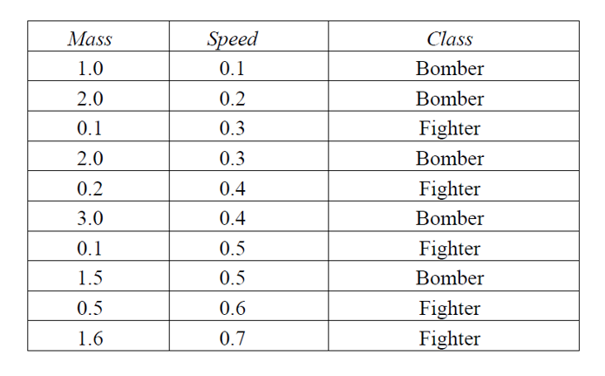
Perceptron: Example 3
Classifying airplanes given their mass and speed.
How is this example different from Examples 1 and 2?

Slide 24
Perceptron: Example 3
Python code
#1 - bomber
#0 - fighter
from sklearn.neural_network import MLPClassifier
#input data
X = [[1.0, 0.1], [2., 0.2], [0.1, 0.3], [2., 0.3], [0.2, 0.4], [3., 0.4],[0.1, 0.5], [1.5, 0.5], [0.5, 0.6], [1.6, 0.7]]
y = [1, 1,0,1,0,1,0,1,0,0]
#calling scikit learn Multi Layer Perceptron (MLP) Classifier
clf = MLPClassifier(solver='lbfgs', alpha=1e-5, hidden_layer_sizes=(5, 2), random_state=1)
#train a classifier
clfit=clf.fit(X, y)
#make predictions
res=clfit.predict([[1., 0.1], [0.2, 0.4]])
print(res)
Output : [1, 0]

Slide 25
Perceptron: Example 3
Python code
#1 - bomber
#0 - fighter
from sklearn.neural_network import MLPClassifier
#input data
X = [[1.0, 0.1], [2., 0.2], [0.1, 0.3], [2., 0.3], [0.2, 0.4], [3., 0.4],[0.1, 0.5], [1.5, 0.5], [0.5, 0.6], [1.6, 0.7]]
y = [1, 1,0,1,0,1,0,1,0,0]
#calling scikit learn Multi Layer Perceptron (MLP) Classifier
clf = MLPClassifier(solver='lbfgs', alpha=1e-5, hidden_layer_sizes=(5, 2), random_state=1)
#train a classifier
clfit=clf.fit(X, y)
#make predictions
clfit.predict([[1., 0.1], [0.2, 0.4]])
Output : [1, 0]

Slide 26
MLPClassifier Decsription
Multi-layer Perceptron classifier.
This model optimizes the log-loss function using LBFGS or stochastic gradient descent.
class sklearn.neural_network.MLPClassifier(hidden_layer_sizes=(100, ), activation=’relu’, solver=’adam’, alpha=0.0001, batch_size=’auto’, learning_rate=’constant’, learning_rate_init=0.001, power_t=0.5, max_iter=200, shuffle=True, random_state=None, tol=0.0001, verbose=False, warm_start=False, momentum=0.9, nesterovs_momentum=True, early_stopping=False, validation_fraction=0.1, beta_1=0.9, beta_2=0.999, epsilon=1e-08, n_iter_no_change=10)
Parameters:
hidden_layer_sizes : tuple, length = n_layers - 2, default (100,)
The ith element represents the number of neurons in the ith hidden layer.
activation : {‘identity’, ‘logistic’, ‘tanh’, ‘relu’}, default ‘relu’
Activation function for the hidden layer.
•‘identity’, no-op activation, useful to implement linear bottleneck, returns f(x) = x
•‘logistic’, the logistic sigmoid function, returns f(x) = 1 / (1 + exp(-x)).
•‘tanh’, the hyperbolic tan function, returns f(x) = tanh(x).
•‘relu’, the rectified linear unit function, returns f(x) = max(0, x)

Slide 27
MLPClassifier Description
Parameters(cont.):
solver : {‘lbfgs’, ‘sgd’, ‘adam’}, default ‘adam’
The solver for weight optimization.
•‘lbfgs’ is an optimizer in the family of quasi-Newton methods.
•‘sgd’ refers to stochastic gradient descent.
•‘adam’ refers to a stochastic gradient-based optimizer proposed by Kingma, Diederik, and Jimmy Ba
Note: The default solver ‘adam’ works pretty well on relatively large datasets (with thousands of training samples or more) in terms of both training time and validation score. For small datasets, however, ‘lbfgs’ can converge faster and perform better.
alpha : float, optional, default 0.0001
L2 penalty (regularization term) parameter.

Slide 28
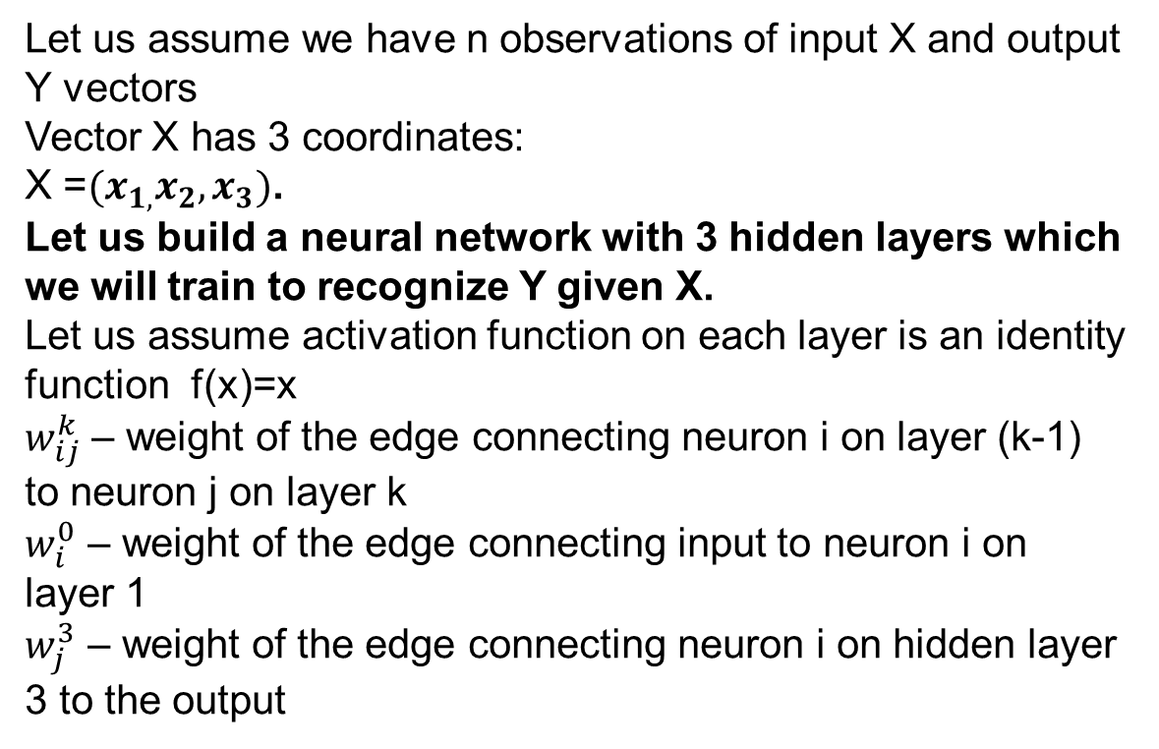
Example 4:Multi Layer Perceptron with 3 Hidden Layers
Let us assume we have n observations of input X and output Y vectors
Vector X has 3 coordinates:
X =${(x}_{1,}x_{2},x_{3})$.
Let us build a neural network with 3 hidden layers which we will train to recognize Y given X.
Let us assume activation function on each layer is an identity function f(x)=x
$w_{ij}^{k}$ – weight of the edge connecting neuron i on layer (k-1) to neuron j on layer k
$w_{i}^{0}$ – weight of the edge connecting input to neuron i on layer 1
$w_{j}^{3}$ – weight of the edge connecting neuron i on hidden layer 3 to the output

Slide 29
Example 4: Multi Layer Perceptron with 3 Hidden Layers

Slide 30
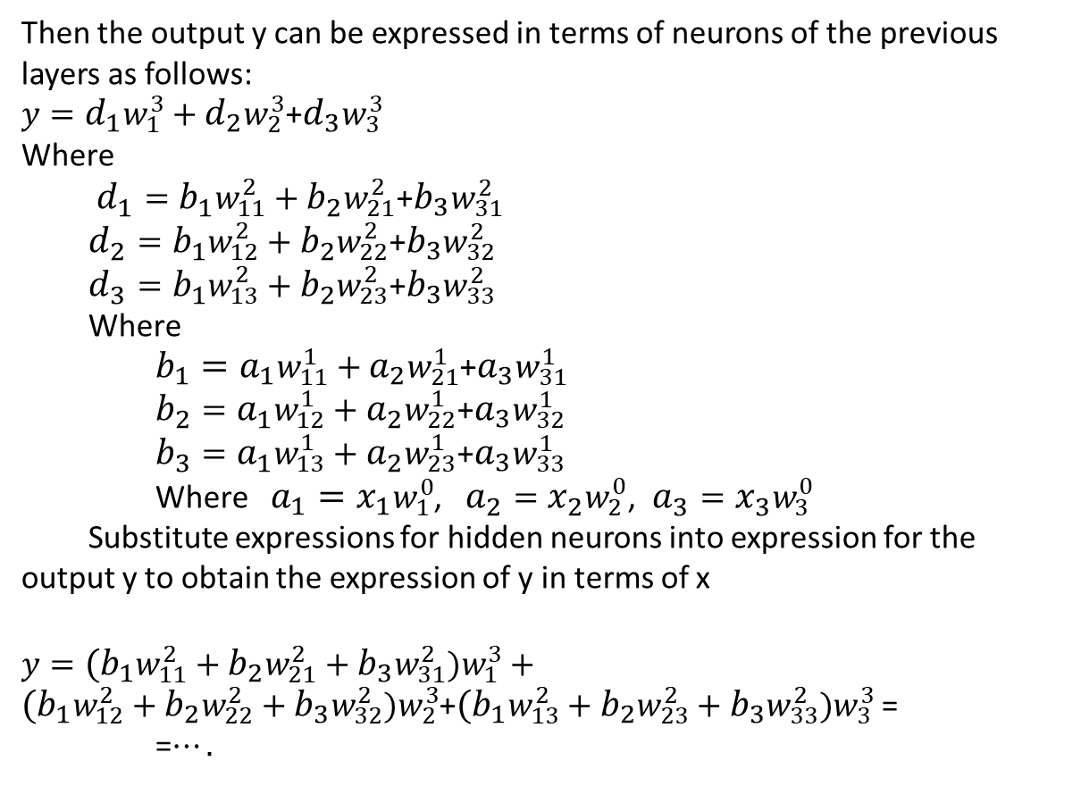
Example 4: Multi Layer Perceptron with 3 Hidden Layers
Then the output y can be expressed in terms of neurons of the previous layers as follows:
$y={d_{1}w}_{1}^{3}+{d_{2}w}_{2}^{3}$+${d_{3}w}_{3}^{3}$
Where
$d_{1}={b_{1}w}_{11}^{2}+{b_{2}w}_{21}^{2}$+${b_{3}w}_{31}^{2}$
$d_{2}={b_{1}w}_{12}^{2}+{b_{2}w}_{22}^{2}$+${b_{3}w}_{32}^{2}$
$d_{3}={b_{1}w}_{13}^{2}+{b_{2}w}_{23}^{2}$+${b_{3}w}_{33}^{2}$
Where
${{b_{1}=a}_{1}w}_{11}^{1}+{a_{2}w}_{21}^{1}$+${a_{3}w}_{31}^{1}$
$b_{2}={a_{1}w}_{12}^{1}+{a_{2}w}_{22}^{1}$+${a_{3}w}_{32}^{1}$
$b_{3}={a_{1}w}_{13}^{1}+{a_{2}w}_{23}^{1}$+${a_{3}w}_{33}^{1}$
Where ${{a_{1}=x}_{1}w}_{1}^{0}$, $a_{2}={x_{2}w}_{2}^{0}$, $a_{3}={x_{3}w}_{3}^{0}$
Substitute expressions for hidden neurons into expression for the output y to obtain the expression of y in terms of x
$y={{{(b}_{1}w}_{11}^{2}+{b_{2}w}_{21}^{2}+{b_{3}w}_{31}^{2})w}_{1}^{3}+{({b_{1}w}_{12}^{2}+{b_{2}w}_{22}^{2}+{b_{3}w}_{32}^{2})w}_{2}^{3}$+${({b_{1}w}_{13}^{2}+{b_{2}w}_{23}^{2}+{b_{3}w}_{33}^{2})w}_{3}^{3}$ =
=$….$

Slide 31
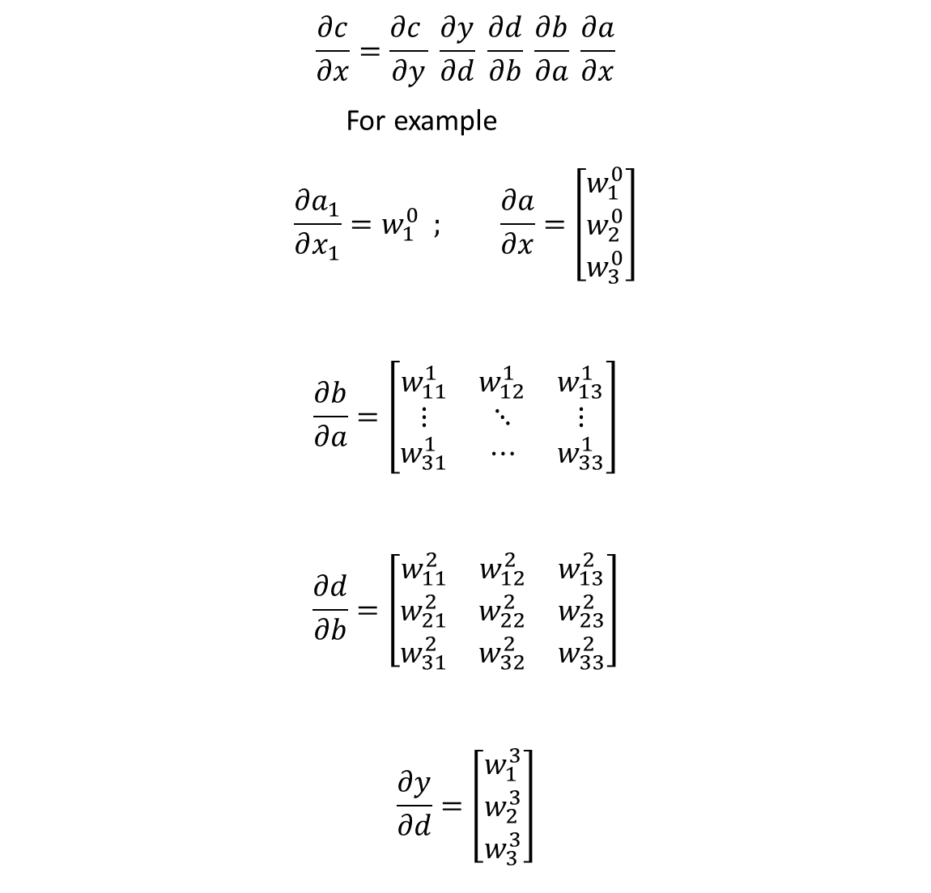
$$\frac{∂c}{∂x}=\frac{∂c }{∂y} \frac{∂y}{∂d} \frac{∂d}{∂b} \frac{∂b}{∂a} \frac{∂a}{∂x}$$
For example
$$\frac{∂a_{1}}{∂x_{1}}=w_{1}^{0} ; \frac{∂a}{∂x}=\left[\begin{matrix}w_{1}^{0} \\ w_{2}^{0} \\ w_{3}^{0}\end{matrix}\right]$$
$$\frac{∂b}{∂a}=\left[\begin{matrix}w_{11}^{1} & w_{12}^{1} & w_{13}^{1} \\ ⋮ & ⋱ & ⋮ \\ w_{31}^{1} & ⋯ & w_{33}^{1}\end{matrix}\right]$$
$$\frac{∂d}{∂b}=\left[\begin{matrix}w_{11}^{2} & w_{12}^{2} & w_{13}^{2} \\ w_{21}^{2} & w_{22}^{2} & w_{23}^{2} \\ w_{31}^{2} & w_{32}^{2} & w_{33}^{2}\end{matrix}\right]$$
$$\frac{∂y}{∂d}=\left[\begin{matrix}w_{1}^{3} \\ w_{2}^{3} \\ w_{3}^{3}\end{matrix}\right]$$

Slide 32
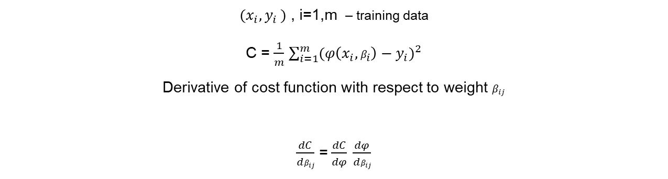
Train perceptron = minimize cost function
Single Layer perceptron ( feed forward Neural Net).
C – cost function
${(x}_{i}{,y}_{i})$ , i=1,m – training data
C = $\frac{1}{m}$ $\sum_{i=1}^{m}{{(φ\left(x_{i},β_{i}\right)−y_{i})}^{2}}$
Derivative of cost function with respect to weight $β_{ij}$
$\frac{dC}{dβ_{ij}}$ =$\frac{dC}{dφ} \frac{dφ}{dβ_{ij}}$

Slide 33
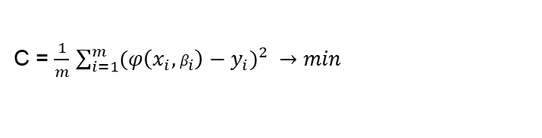
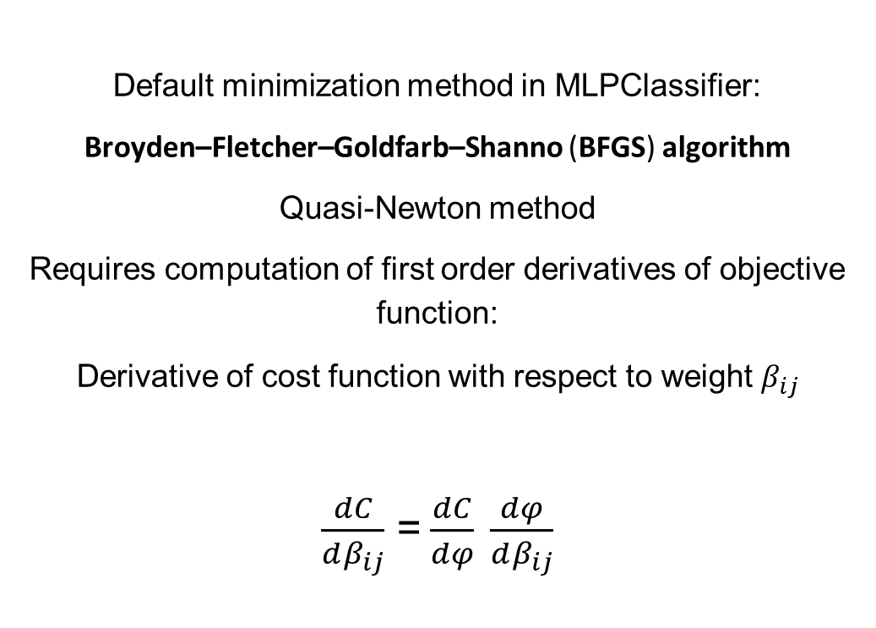
Cost Function Minimization
C = $\frac{1}{m}$ $\sum_{i=1}^{m}{{(φ\left(x_{i},β_{i}\right)−y_{i})}^{2} →min}$
Default minimization method in MLPClassifier:
Broyden–Fletcher–Goldfarb–Shanno (BFGS) algorithm
Quasi-Newton method
Requires computation of first order derivatives of objective function:
Derivative of cost function with respect to weight $β_{ij}$
$\frac{dC}{dβ_{ij}}$ =$\frac{dC}{dφ} \frac{dφ}{dβ_{ij}}$

Slide 34
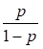
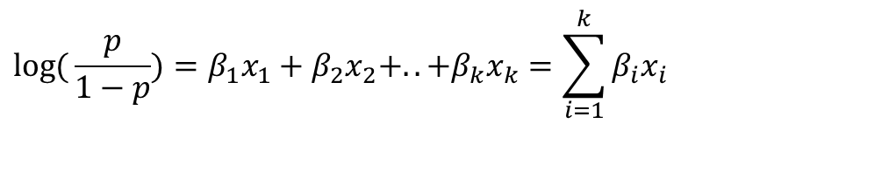
Sigmoid
let Y be the observed status of the firm at the end of some predetermined
time horizon. Let Y = 1 if the firm has defaulted and 0 otherwise. Let us denote the probability of default by p (0< =p <= 1)
- odds (the ratio of favorable to unfavorable cases) that Y equals 1
where is the probability that Y = 1
logit function - the natural log of the odds that Y=1
log
The following equation represents the linear dependency between logit function and parameter vector X.
$$\log{(}\frac{p}{1−p})=β_{1}x_{1}+β_{2}x_{2}+..+β_{k}x_{k}=\sum_{i=1}^{k}{β_{i}x_{i}}$$

Slide 35
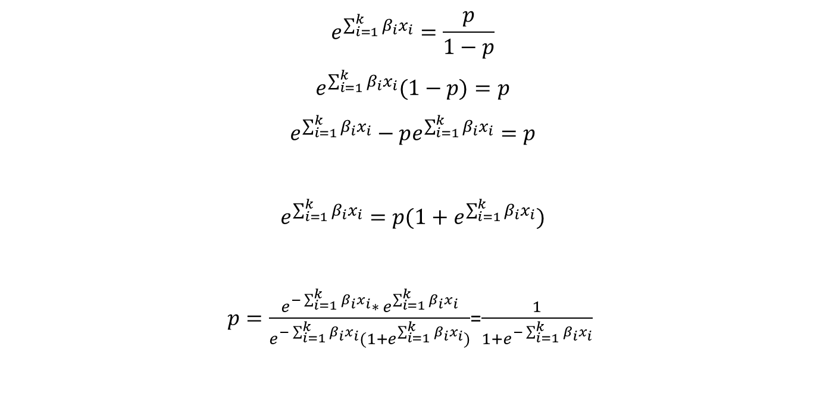
Sigmoid
$$e^{\sum_{i=1}^{k}{β_{i}x_{i}}}=\frac{p}{1−p}$$
$$e^{\sum_{i=1}^{k}{β_{i}x_{i}}}(1−p)=p$$
$$e^{\sum_{i=1}^{k}{β_{i}x_{i}}}−pe^{\sum_{i=1}^{k}{β_{i}x_{i}}}=p$$
$$e^{\sum_{i=1}^{k}{β_{i}x_{i}}}=p(1+e^{\sum_{i=1}^{k}{β_{i}x_{i}}})$$
$p=\frac{{e^{−\sum_{i=1}^{k}{β_{i}x_{i}}}∗ e}^{\sum_{i=1}^{k}{β_{i}x_{i}}}}{e^{−\sum_{i=1}^{k}{β_{i}x_{i}}}(1+e^{\sum_{i=1}^{k}{β_{i}x_{i}}})}$=$\frac{1}{1+e^{−\sum_{i=1}^{k}{β_{i}x_{i}}}}$

Slide 36
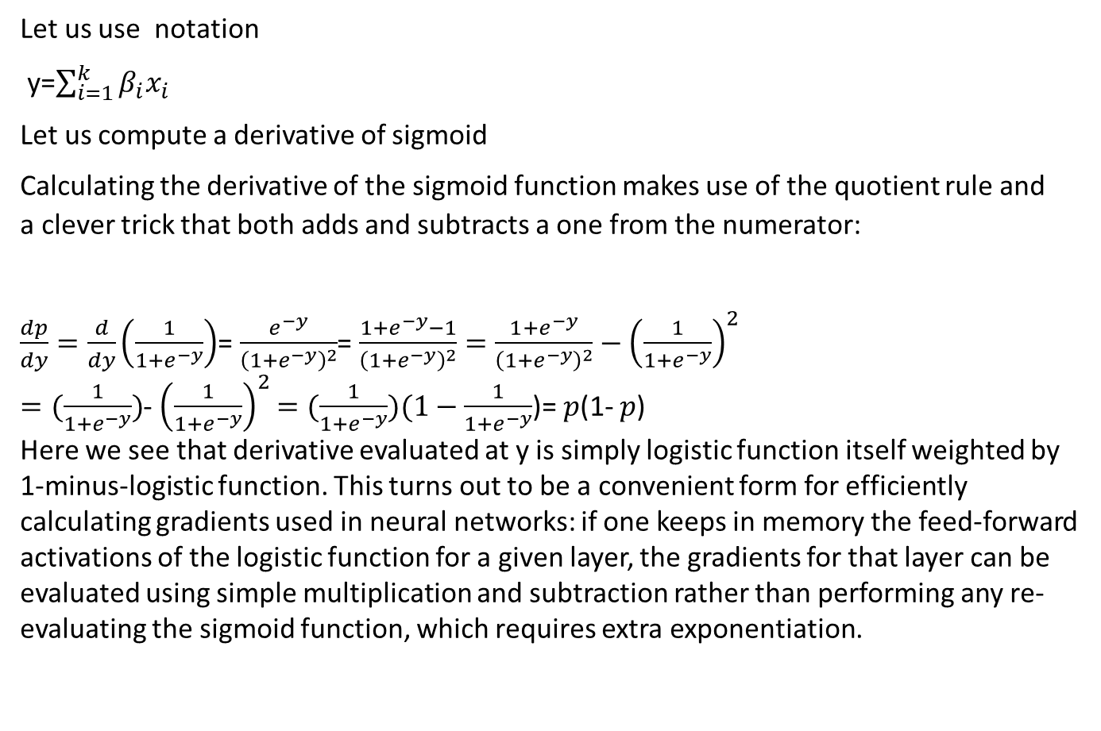
Derivative of Sigmoid
Let us use notation
y=$\sum_{i=1}^{k}{β_{i}x_{i}}$
Let us compute a derivative of sigmoid
Calculating the derivative of the sigmoid function makes use of the quotient rule and a clever trick that both adds and subtracts a one from the numerator:
$\frac{dp}{dy}=\frac{d}{dy}\left(\frac{1}{1+e^{−y}}\right)$=$\frac{e^{−y}}{{\left(1+e^{−y}\right)}^{2}}$=$\frac{1+e^{−y}−1}{{\left(1+e^{−y}\right)}^{2}}=\frac{1+e^{−y}}{{\left(1+e^{−y}\right)}^{2}}−{\left(\frac{1}{1+e^{−y}}\right)}^{2}$
$=(\frac{1}{1+e^{−y}})$-${\left(\frac{1}{1+e^{−y}}\right)}^{2}$ $=(\frac{1}{1+e^{−y}})(1−\frac{1}{1+e^{−y}}$)= $p$(1- $p$)
Here we see that derivative evaluated at y is simply logistic function itself weighted by 1-minus-logistic function. This turns out to be a convenient form for efficiently calculating gradients used in neural networks: if one keeps in memory the feed-forward activations of the logistic function for a given layer, the gradients for that layer can be evaluated using simple multiplication and subtraction rather than performing any re-evaluating the sigmoid function, which requires extra exponentiation.

Slide 37
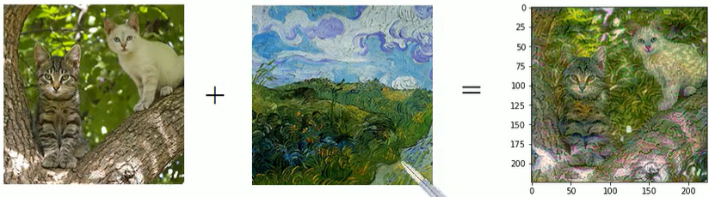

Convolutional Neural Networks (CNN)
Applications
Image classification, image and video recognition, text recognition, recommender systems, image segmentation, image processing, text recognition, natural language processing, financial time series

Slide 38
Convolutional Neural Networks (CNN)
Questions:
Why CNN?
Advantages over MLP
Types of data:
better suited for MLP?
Better suited for CNN?
Image data? (what are the properties of image data?)
Movie dataset (what are the properties of this dataset?)
Inhomogeneous/homogeneous, numerical/non-numerical

Slide 39
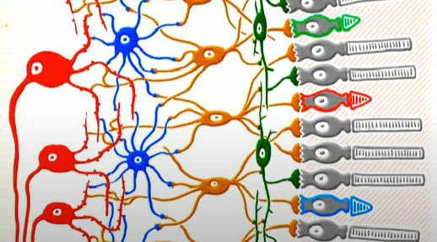
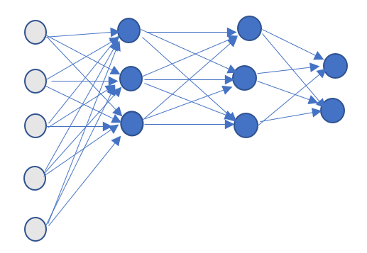
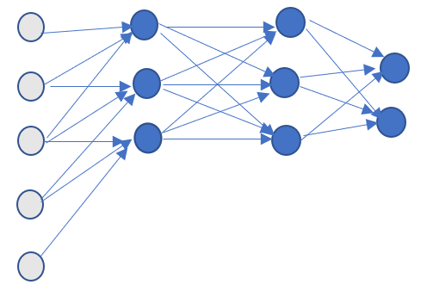
Convolutional Neural Networks
Idea: modeled after receptive field of animals visual cortex
Compare to feed-forward fully connected neural networks!

Slide 40

Convolutional Neural Networks (CNN)
History
Late 1980s - CNN is introduced
1987 (Yann LeCun) BackPropagation training of CNN, foundation of modern computer vision
2012 (AlexNet by Alex Krizhevsky) growing popularity of CNN

Slide 41
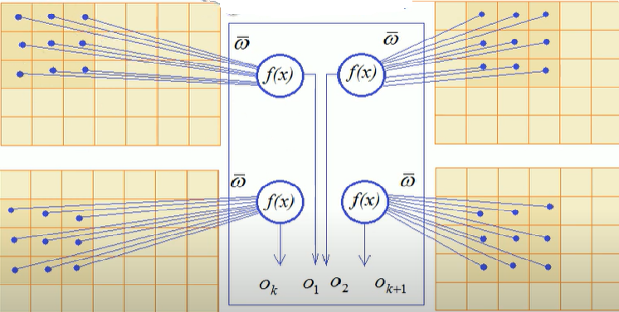
Convolutional Neural Networks
First layer of neurons: matrix of weights is the same for each neuron
Hyper – parameters: parameters that are not adjusted during training of the network
Hyper-parameters of CNN: number of input and output signals, filter/kernel size, number of channels ( hidden layers), stride, padding

Slide 42
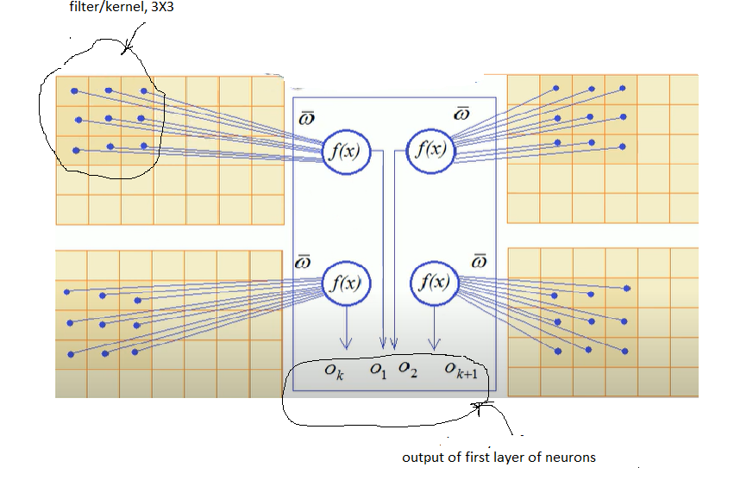
Convolutional Neural Networks
First layer of neurons: Weights are the same for each neuron

Slide 43
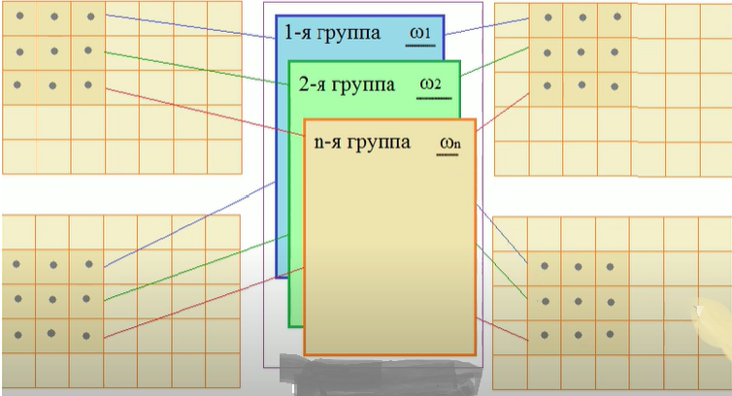
Convolutional Neural Networks
Next hidden layers (channels)

Slide 44
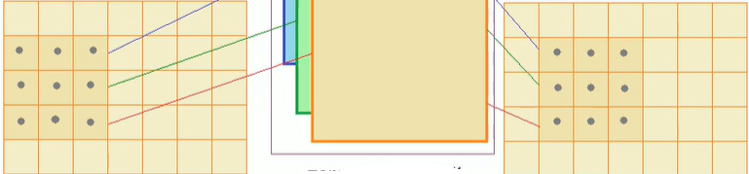
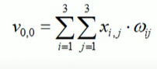
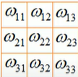
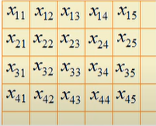
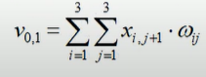
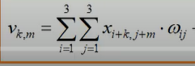
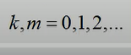
Convolutional Neural Networks
Number of adjustable parameters: 3*3*n

Slide 45
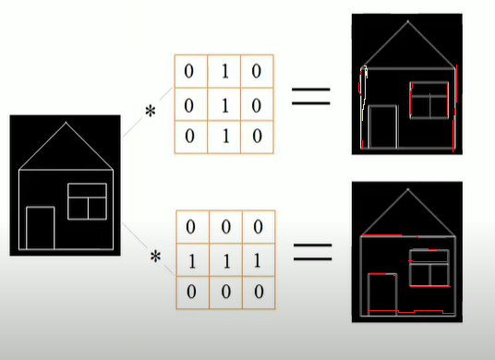
Convolutional Neural Networks
example of filters/kernels

Slide 46
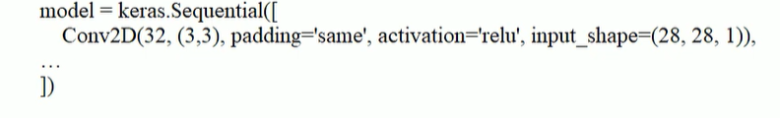
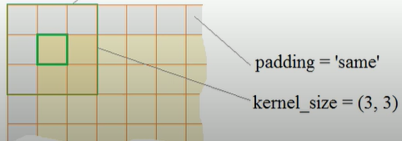
Convolutional Neural Networks
Tensorflow/Keras example
Conv2D layer:
Parameters: padding, activation, input_shape

Slide 47
Convolutional Neural Networks
Terminology
Convolution (in machine learning) mixes the convolutional filter and the input matrix in order to train weights.
Without convolutions, a machine learning algorithm would have to learn a separate weight for every cell in a large tensor.
Thanks to convolutions, a machine learning algorithm only has to find weights for every cell in the convolutional filter, dramatically reducing the memory needed to train the model. When the convolutional filter is applied, it is simply replicated across cells such that each is multiplied by the filter. In machine learning algorithms, convolutional filters are typically seeded with random numbers and then the network trains the ideal values.

Slide 48
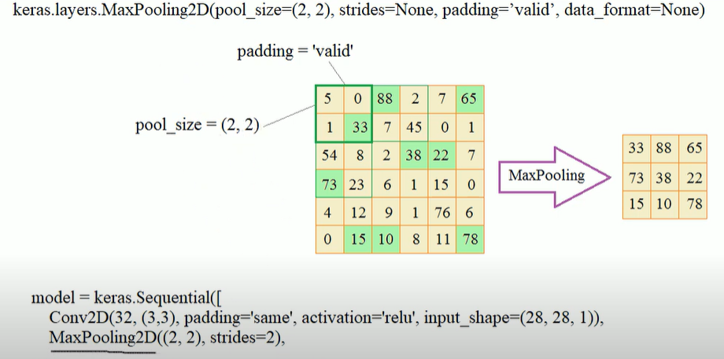
Convolutional Neural Networks
Tensorflow/Keras example
pooling layer:
Parameters: padding, pool_size,strides, Strides – shift of filtering window

Slide 49
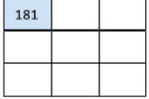
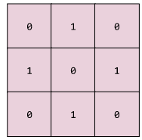
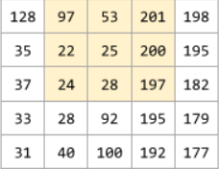




Convolutional Neural Networks
Convolutional layer [2]
A layer of a deep neural network in which a convolutional filter passes along an input matrix. For example, 3x3 convolutional filter applied to 5X5 matrix:
matrix X result C
filter F
181 = 0*128+1*97+0*53+1*35+0*22+1*25+0*37+1*24+0*28
303 = 0*97+1*53+0*201+1*22+0*25+1*200+0*24+1*28+0*197
560 = 0*28+1*197+0182+1*92+0*195+1*179+0*100+1*192+0*177
${ c}_{km}=\sum_{i=1}^{3}{\sum_{j=1}^{3}{\left(f_{ij}x_{i+k,j+m}\right)}}$, k,m=0,1,2,

Slide 50


Convolutional Neural Networks
Pooling layer [2] Matrix C
Reducing a matrix created by an earlier convolutional layer to a smaller matrix.
Maximum pooling - taking the maximum value across the pooled area.
Average pooling – taking the average value across the pooled area.
For example, suppose we have the following 3x3 matrix – result of convolutional operation:
The pooling operation divides the convolutional matrix into 2x2 slices with a 1x1 stride.
Four pooling operations take place. Each pooling operation picks the maximum value of the four in that slice:
Pooling helps enforce translation invariance in the input matrix. Translation invariance - ability of the algorithm to successfully classify images even when the position of objects within the image changes

Slide 51
Convolutional Neural Networks
Dense (fully connected) layer [2]
A hidden layer in which each node is connected to every node in the subsequent hidden layer.

Slide 52
Convolutional Neural Networks
Tensorflow/Keras loss functions
The purpose of loss functions is to compute the quantity that a model should seek to minimize during training.
Sparse Categorical cross-entropy - computes the cross-entropy loss between the labels and predictions.
Use this loss function when there are two or more label classes.
Labels should be provided as integers.
Categorical cross-entropy - use this loss function when there are two or more label classes.
Provide labels using one-hot representation.
A one hot encoding is a representation of categorical variables as binary vectors. This first requires that the categorical values be mapped to integer values. Then, each integer value is represented as a binary vector that is all zero values except the index of the integer, which is marked with a 1
Cross-entropy is a measure of the difference between two probability distributions for a given random variable or set of events.

Slide 53
Recurrent Neural Networks (RNN)
Applications
Question Answering, Language Translation (machine translation), Speech Recognition, Language Modeling
https://towardsdatascience.com/language-translation-with-rnns-d84d43b40571#:~:text=RNN%20Overview,at%20the%20next%20time%20step.

Slide 54







Recurrent Neural Networks
Idea: networks with memory
Compare to feed-forward fully connected neural networks!

Slide 55


Recurrent Neural Networks (RNN)
History
1982 – Hopfield Networks (John Hopfield) – associative memory systems with binary threshold nodes
1990 – Simple recurrent neural network (Jeffrey Elman)
1997 – LSTM (Hochreiter and Schmidhuber ) – long short-term memory unit
2014 – GRU (Kyunghyun Cho) – gaited recurrent unit

Slide 56

Recurrent Neural Networks (RNN)
Text analysis
Analyzing text as sequence of symbols with fully connected (dense) ANN
all tokens are sent to the input of each neuron, tokens are analyzed separately from each other
Examples of sequences that dense ANN cannot analyze correctly
Overall, the movie is not bad and has entertainment value
Unfortunately, the movie is not so good
Ice cream
Analyze text as sequence of tokens – need some other type of ANN
Order of tokens is important
After unrolling RNN can be trained using backpropagation algorithm
Problems: training takes long time, vanishing gradient, restricted “memory” size
Solution: LSTM

Slide 57
Recurrent Neural Networks (CNN)
Questions:
Why RNN?
Advantages over MLP and CNN
Types of data:
better suited for MLP?
Better suited for CNN?
Better suited for RNN?
Sequential data, image data, numerical data, text data?

Slide 58




Recurrent Neural Networks (RNN)
Hopfield Networks – associative memory
Hopfield Networks with 4 neurons.
Networks consists of one layer of neurons, each neuron is connected to all others.
There is no feedback from the output of neuron to its own input.
Hopfield algorithm for image reproduction:
1. Compute weights:
${ w}_{ij}=$0 if i=j
2. Initialization
${ o}_{i}(0)=$0 , $1≤i≤$n – output of neuron I at time 0
3. Repeat
Until $o_{i}\left(t+1\right)$= $o_{i}\left(t\right)$ for all i, $1≤i≤$n
where $o_{i}\left(t\right)$ - output of neuron I at time t
The image X can be reproduced using the equality f(WX)=X, where f is activation function, W is weight matrix and X is input vector
Note that for any input vector ${X=(x}_{1}$, $x_{2}$,.. $x_{n}$ ) that network has to reproduce the weights can be computed.
$w_{ij}=\sum_{s=0}^{k−1}{x_{sj}}x_{sj}$, for all i ≠j
$o_{i}\left(t+1\right)=f_{h}\sum_{i=0}^{n−1}{w_{ij}}o_{j}$(t)

Slide 59


Recurrent Neural Networks (RNN)
Example: reproduction of the image using Hopfield network
The image (input vector) has the following form X=(-1, 1, 1,-1)
0 -1 -1 1
Weight matrix $W=$ -1 0 1 -1
-1 1 0 -1
1 -1 -1 0
If incorrect image is received by network only one iteration is needed to correct it:
0 -1 -1 1 X (-1, 1, 1, -1)
-1 0 1 -1
-1 1 0 -1 = (-1, 1, 1, -1)
1 -1 -1 0

Slide 60

Recurrent Neural Networks
Basic RNN
keras.layers.SimpleRNN, a fully-connected RNN where the output from previous timestep is to be fed to next timestep.

Slide 61


Recurrent Neural Networks
LSTM
Capable of learning long-term dependencies
keras.layers.LSTM
Basic RNN LSTM

Slide 62




Recurrent Neural Networks
LSTM
3 gates: input, forget and output
- sigmoid function - dot product

Slide 63

Recurrent Neural Networks
GRU
Combines input gate and forget gate into update gate
keras.layers.GRU, first proposed in Cho et al., 2014.

Slide 64
Recurrent Neural Networks
Tensorflow/Keras
keras.layers.SimpleRNN, a fully-connected RNN where the output from previous timestep is to be fed to next timestep.
keras.layers.GRU, first proposed in Cho et al., 2014.
keras.layers.LSTM, first proposed in Hochreiter & Schmidhuber, 1997.
https://colah.github.io/posts/2015-08-Understanding-LSTMs/

Slide 65
Regularized regression
Lasso Regression
sklearn.linear_model.Lasso — scikit-learn 0.24.2 documentation
https://www.tutorialspoint.com/scikit_learn/scikit_learn_lasso.htm
How to Develop LASSO Regression Models in Python (machinelearningmastery.com)
Ridge Regression
https://scikit-learn.org/stable/modules/generated/sklearn.linear_model.Ridge.html
https://www.tutorialspoint.com/scikit_learn/scikit_learn_ridge_regression.htm

Slide 66

Lasso Regression
(least absolute shrinkage and selection operator)
Shrinkage - data values are shrunk towards a central point, like the mean.
Linear Model with L1 penalty
Least squares objective in 2D:
$\sum_{i=0}^{n}{ {\left(ax_{i}+b \text{−}y_{i}\right)}^{2}}$→ $\min_{a,b}$
Least squares objective in n-dim space:
$f\left(w\right)={||y−w^{T}x||}_{2}^{2}$, s.t. ${||w||}_{1}<t$ (t – constant, degree of regularization)
where ${(x}_{i,}y_{i}$) represent some observations of the process with input $x_{i,}$ and output $y_{i}$ , i = 1,..,m
y = $w^{T}x_{i}$- model
Lasso: adding constraints to the original least squares formulation.
$f\left(w\right)={||y−w^{T}x||}_{2}^{2}$, s.t. ${||w||}_{1}<t$ (t – constant, degree of regularization)
Constraints can be represented as penalty as follows:
$f\left(w\right)={||y−w^{T}x||}_{2}^{2}+$ ${a||w||}_{1}$
Example: https://scikit-learn.org/stable/auto_examples/inspection/plot_linear_model_coefficient_interpretation.html#sphx-glr-auto-examples-inspection-plot-linear-model-coefficient-interpretation-py

Slide 67

Ride Regression
Linear Model with L2 penalty
Least squares objective in 2D:
$\sum_{i=0}^{n}{ {\left(ax_{i}+b \text{−}y_{i}\right)}^{2}}$→ $\min_{a,b}$
Least squares objective in n-dim space:
$f\left(w\right)={||y−w^{T}x||}_{2}^{2}$, s.t. ${||w||}_{1}<t$ (t – constant, degree of regularization)
where ${(x}_{i,}y_{i}$) represent some observations of the process with input $x_{i,}$ and output $y_{i}$ , i = 1,..,m
y = $w^{T}x_{i}$- model
Ridge: adding constraints to the original least squares formulation.
$f\left(w\right)={||y−w^{T}x||}_{2}^{2}$, s.t. ${||w||}_{2}<t$ (t – constant, degree of regularization)
Constraints can be represented as penalty as follows:
$f\left(w\right)={||y−w^{T}x||}_{2}^{2}+$ ${a||w||}_{2}$

Slide 68


Kernel methods
Blue and red points are not linearly separable Blue and red points are linearly separable

